Slide 1
NEURAL NETWORK TECHNIQUE FOR DETECTING FACIAL EXPRESSIONS OF EMOTION
Submitted in the partial fulfillment for the award of the degree of
BACHELOR OF ENGINEERING
IN
AIT-CSE/AIML
Submitted by:
KOPPULA PRAKASH - 21BCS8824
MARAM LEELA KRISHNA SUBRAHMANYAM - 21BCS8803
NIKHIL KUMAR - 20BCS6845
ARYA CHAKRABORTY – 21BCS8814
Under the Supervision of:
MS.SHUBHANGI MISHRA
Department of AIT-CSE
DISCOVER . LEARN . EMPOWER

Slide 2
Outline
Introduction to Project
Problem Formulation
Objectives of the work
Methodology used
Results and Outputs
Conclusion
Future Scope
References

Slide 3
Introduction to Project
Facial expression recognition is the process of identifying human emotion. This is both something that humans do automatically but computational methodologies have also been developed.
The facial expression of human emotion is one of the major topics in facial recognition, and it can generate both technical and everyday application beyond laboratory experiment.
This projection constructs a system of deep learning model to classify a given image of human facial emotion into one of the seven basic human emotions.
In general, people infer the emotional state of other people, such as joy, sadness and anger, using facial expressions and vocal tones.
Facial Emotion Recognition is now used in many applications and their exposure to humans is increasing.
To improve Human Computer Interaction (HCI) and make it more natural, machines must be provided with the capability to understand the surrounding environment, especially the intentions of humans.
If computers are able to keep track of the mental state of the user, robots can react upon this and behave appropriately. Emotion recognition therefore plays a key-role in improving human machine interaction.

Slide 4
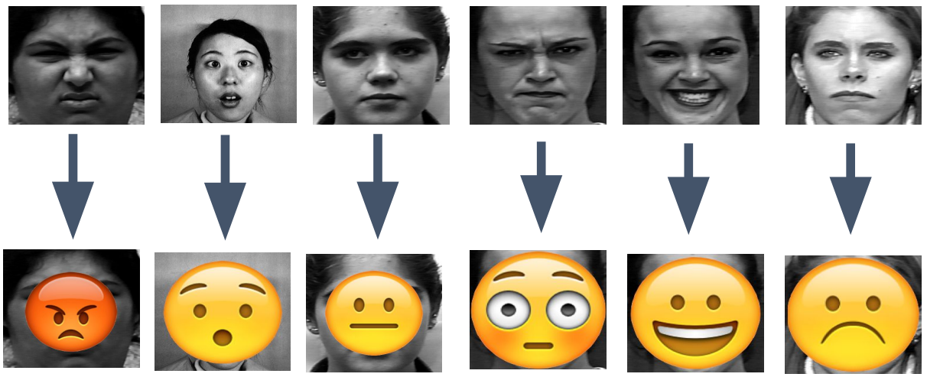
A demonstration: The emojis are correctly imposed on their corresponding faces. There are seven different emotions: happy, angry, sad, fear, surprise, neutral, and disgust. The input will be raw image of the expression, and output will be shown as above. The demonstration does not include disgust as its emoji is like angry.

Slide 5
Problem Formulation
In real life, people express their emotion on their face to show their psychological activities and attitudes in the interaction with other people. The primary focus of this project is to determine which emotion an input image that contains one facial emotion belongs to.
Because human face is complex to interpret, emotion recognition can be specifically divided into classification of basic emotion and classification of compound emotion. For the goals of our project, the essential problem is to focus on the classification of 7 basic emotions.
There are seven different emotions: happy, angry, sad, fear, surprise, neutral, and disgust.
During software development, clones can occur in software intentionally or unintentionally. Developers tend to clone fragments of software during development to save efforts and expedite the development process.

Slide 6
Cont..
The existing techniques are not able to detect all types of vulnerable code clones. Different approaches suffer from high false negative rate and not scalable to large software systems due to high time complexity.
So firstly, there is a need of Haar cascade classifier. Second same subject systems should be used to compare the approaches which detect with this, the problems can be resolved by giving the better weights to model after repeating the steps of training.
So, problems may arise in that. But it can be formulated and resolved by presenting correct conditions for different scenario.

Slide 7
Objectives of the Work
The proposed work is aimed to carry out work leading to the development of an approach for Facial Emotion Recognition. The proposed aim will be achieved by dividing the work into following objectives.
1. Image data loading and visualization
2. Identify facial emotions using machine learning classifiers
3. Identify facial emotions using (convolutional) neural networks
4. Explore how sample diversity affects performance
The objective of face emotion recognition (FER) is identifying emotions of a human. The emotion can be captured either from face or from verbal communication. Psychological characteristics such as heartbeat and blood
Pressure, speech, hand gestures, body movements, Facial expressions identify emotions of a person.

Slide 8
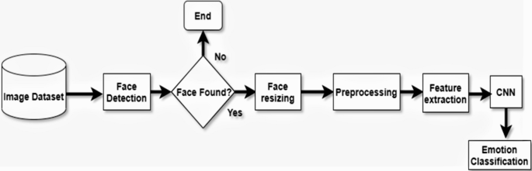
Methodology

Slide 9
Cont..
The main modules used in this project are NumPy, Pandas, scikitplot, seaborn, sklearn, tensorflow, Keras layers and some CNN functions.
Convolutional neural network (CNN) is the most popular way of analyzing images.
CNN works majorly on three layers namely Convolutional Layer, Pooling Layer and Fully-Connected Layer, which are responsible for pixel segmentation and calculations of the matrices.
Huge dataset of facial emotions in image format is used in the model called, FER-2013.
With the help of the Epoches we are able to increase the accuracy of the model by training the model various number of times.
Following step is loading of the pre trained model into the OpenCv to run the model and as well as classifying the various facial expressions of emotions through the live web cam.

Slide 10
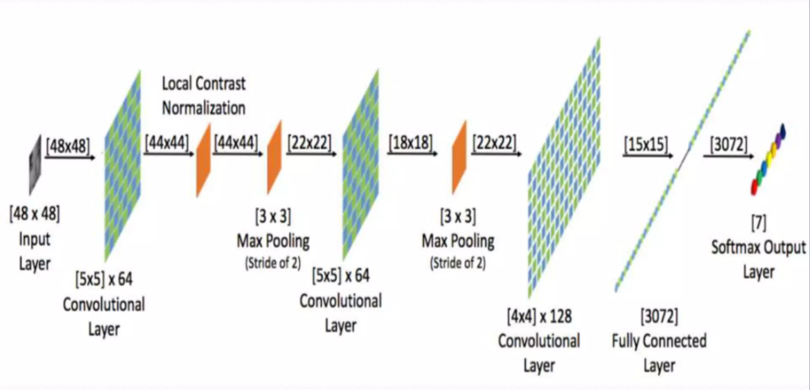
System Architecture

Slide 11
Conclusion
In this project, I studied the what are the techniques used previously which mentioned in literature survey, what are the real time application for the proposed system which covered in objective and motivation.
By using the mentioned dataset the neural network will be trained and by adding maximum hidden layer i.e with deep layer in convolutional network the result will be calculated.
It covers the concept of facial expression recognition with aimed to classify images of faces into any of seven discrete emotion or face expression categories that represent universal human emotions.

Slide 12
Future Scope
Facial emotion recognition is an emerging field so considering other NNs such as Recurrent Neural Networks (RNNs) may improve the accuracy.
The feature extraction is similar to pattern recognition which is used in intelligence, military and forensics for identification purposes. Thus, techniques such as the Capsnet algorithm for pattern recognition can be considered.
DL based approaches require a large labeled dataset, significant memory and long training and testing times which makes them difficult to implement on mobile and other platforms with limited resources.
Thus, simple solutions should be developed with lower data and memory requirements.

Slide 13
References
https://www.researchgate.net/publication/344331972_Facial_Emotion_Detection_Using_Neural_Network/link/5f68e384a6fdcc0086340933/download
https://www.ripublication.com/ijaer18/ijaerv13n8_119.pdf
https://peltarion.com/knowledge-center/modeling-view/build-an-ai-model/blocks/2d-convolution
https://www.upgrad.com/blog/basic-cnn-architecture/
https://www.researchgate.net/figure/Visualization-of-a-fully-connected-layer-Taken-from-Hollemans-72_fig4_336607800
https://www.researchgate.net/figure/A-pair-of-convolution-and-pooling-layers-in-the-CNN-architecture_fig1_323233791
https://en.wikipedia.org/wiki/NumPy
https://en.wikipedia.org/wiki/Pandas_(software)
https://en.wikipedia.org/wiki/TensorFlow
https://matplotlib.org/stable/gallery/misc/logos2.html

